Slide 1
UCI Wine Dataset: K-Means vs Hierarchical Clustering
Objective: Cluster wines using 13 physico-chemical attributes.
Compare K-Means vs Hierarchical. Workflow: Load → EDA → Feature Engineering → PCA → Clustering → Validation → Inference
TUSIIME JENINAH
KIJJIBO ADRIAN
OBONG JOSEPH
MUHEREZA EMMANUEL
ASIIMWE HORACE
MASAABA EVANS

Slide 2
Part A: Data Loading & Pre-processing
Loaded UCI Wine dataset with 13 numeric features.
Checked missing values (none). Standardized with Z-score.
Saved scaled dataset for reproducibility.
from sklearn.datasets import load_wine import pandas as pd, numpy as np from sklearn.impute import SimpleImputer from sklearn.preprocessing import StandardScaler X = pd.DataFrame(load_wine().data, columns=load_wine().feature_names) X_imp = pd.DataFrame(SimpleImputer(strategy='median').fit_transform(X), columns=X.columns) X_scaled = pd.DataFrame(StandardScaler().fit_transform(X_imp), columns=X.columns) X_scaled.to_csv('scaled_wine.csv', index=False)

Slide 3
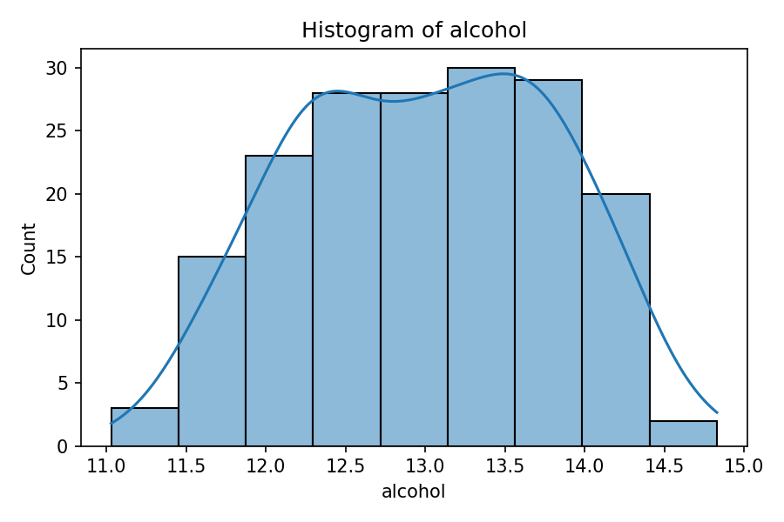
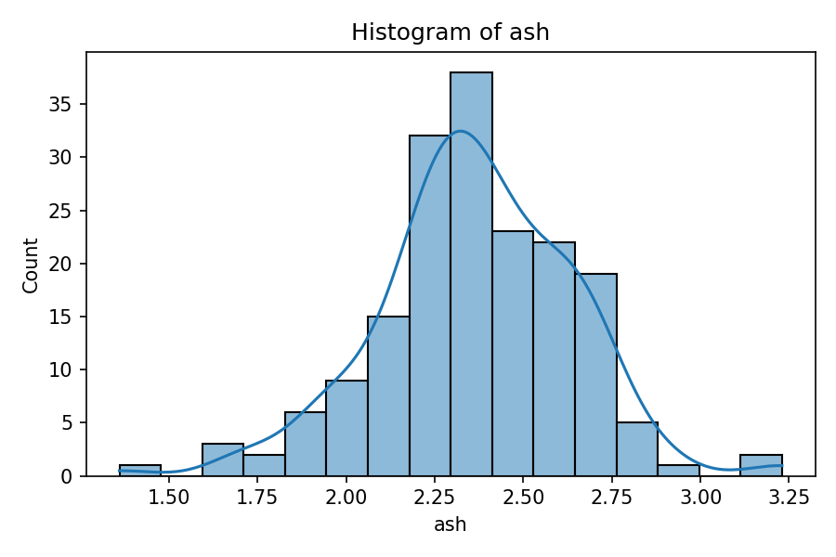
Part B: EDA – Distributions
import matplotlib.pyplot as plt for col in ['alcohol','ash','flavanoids']: plt.figure(); plt.hist(X_imp[col], bins=10); plt.title(f'Histogram of {col}'); plt.show()
Alcohol ≈ symmetric; Ash ≈ near-normal; Flavanoids = multimodal.
Histograms + KDE highlight spread/outliers.

Slide 4
Part C: Feature Engineering & PCA
Composite features: acid_index = malic_acid / alcohol;
phenols_ratio = total_phenols / (flavanoids + 1e-6).
PCA retains 95% variance (~10 comps) to reduce redundancy.
from sklearn.decomposition import PCA acid_index = X_imp['malic_acid'] / X_imp['alcohol'] phenols_ratio = X_imp['total_phenols'] / (X_imp['flavanoids'] + 1e-6) X_fe = X_scaled.copy(); X_fe['acid_index'] = acid_index; X_fe['phenols_ratio'] = phenols_ratio pca95 = PCA(n_components=0.95, svd_solver='full'); X_pca = pca95.fit_transform(X_scaled)

Slide 5
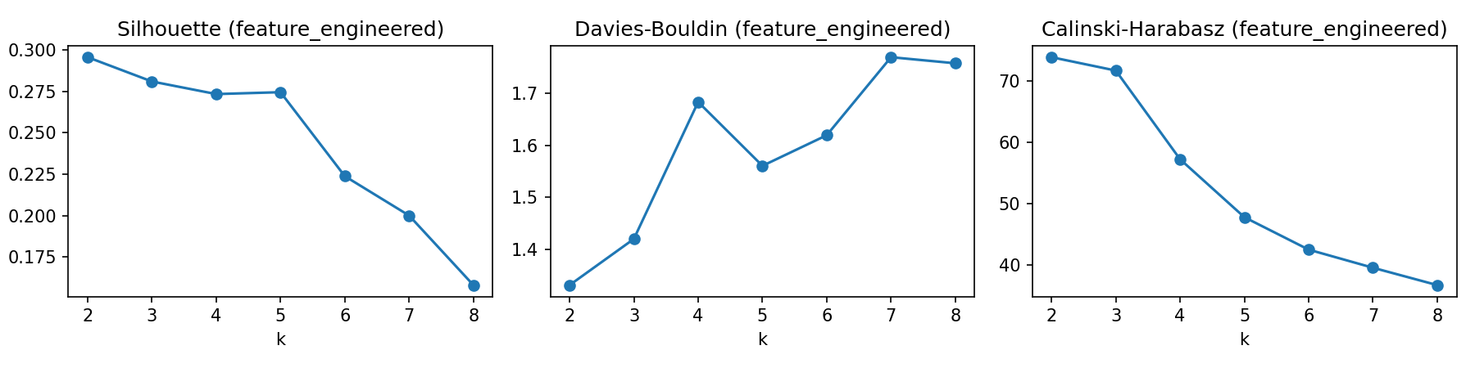
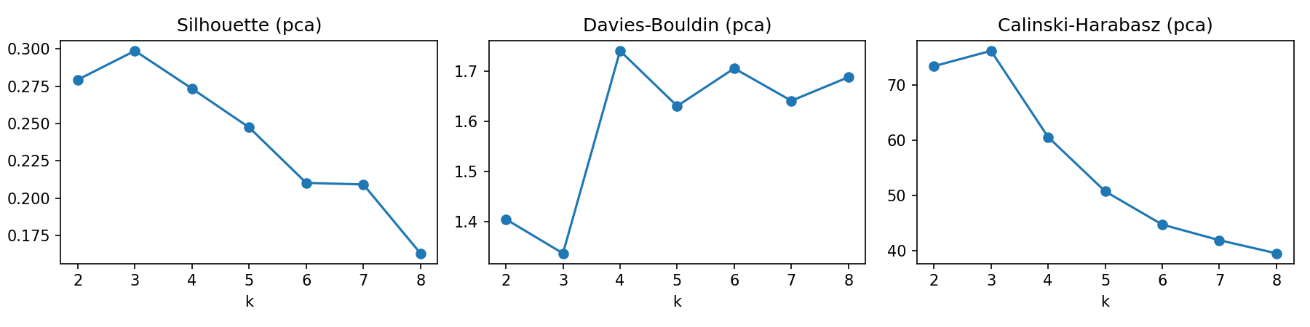
Part D: K-Means – Indices vs k
k = 2..8 evaluated with Silhouette (↑), Davies–Bouldin (↓), Calinski–Harabasz (↑).
Best balance at k = 3 (post-PCA).
from sklearn.cluster import KMeans from sklearn.metrics import silhouette_score, davies_bouldin_score, calinski_harabasz_score scores = [] for k in range(2,9): km = KMeans(n_clusters=k, n_init=10, random_state=42) lab = km.fit_predict(X_pca) scores.append((k, silhouette_score(X_pca, lab), davies_bouldin_score(X_pca, lab), calinski_harabasz_score(X_pca, lab)))

Slide 6
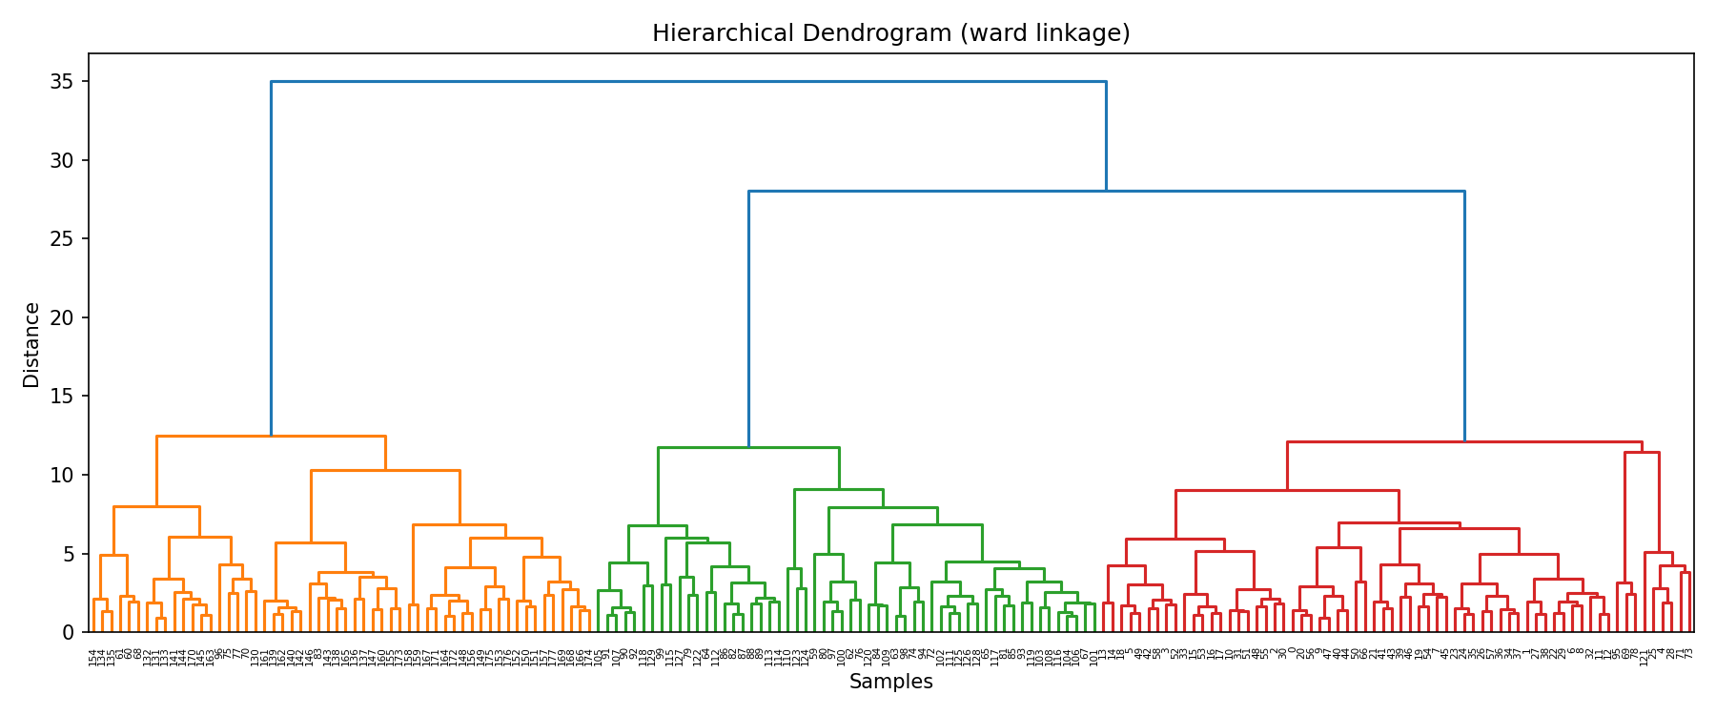
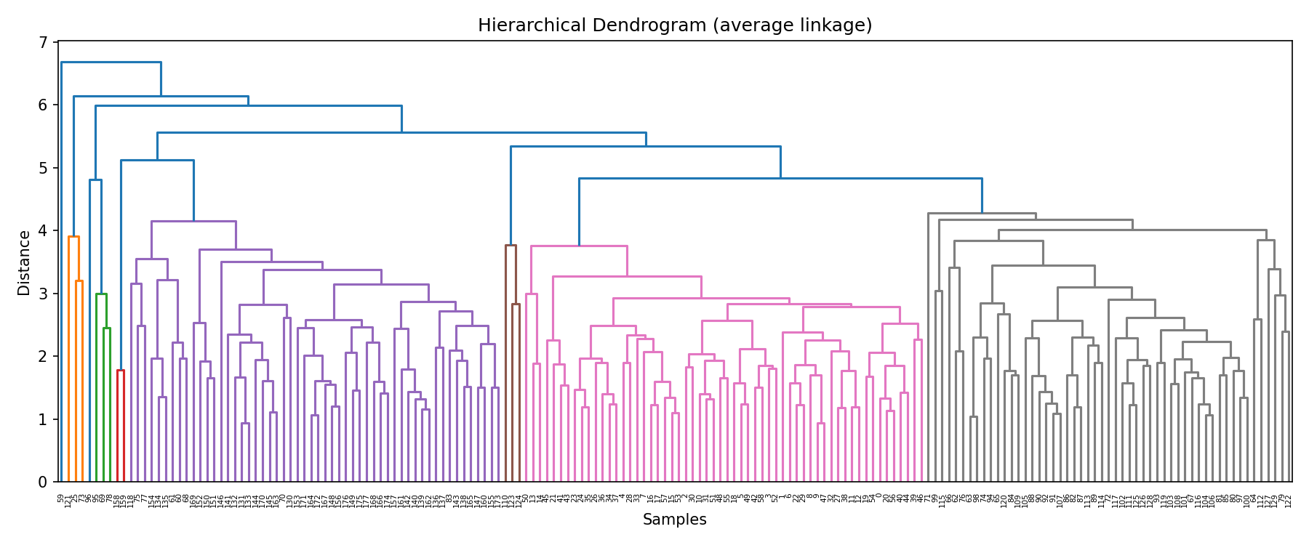
Part D: Hierarchical – Ward & Average
Ward minimizes within-cluster variance; Average uses mean pairwise distance.
Cophenetic: Ward ≈ 0.664; Average ≈ 0.761.
from scipy.cluster.hierarchy import linkage, dendrogram, cophenet from scipy.spatial.distance import pdist Zw = linkage(X_pca, method='ward') Za = linkage(X_pca, method='average') coph_w,_ = cophenet(Zw, pdist(X_pca)); coph_a,_ = cophenet(Za, pdist(X_pca))

Slide 7
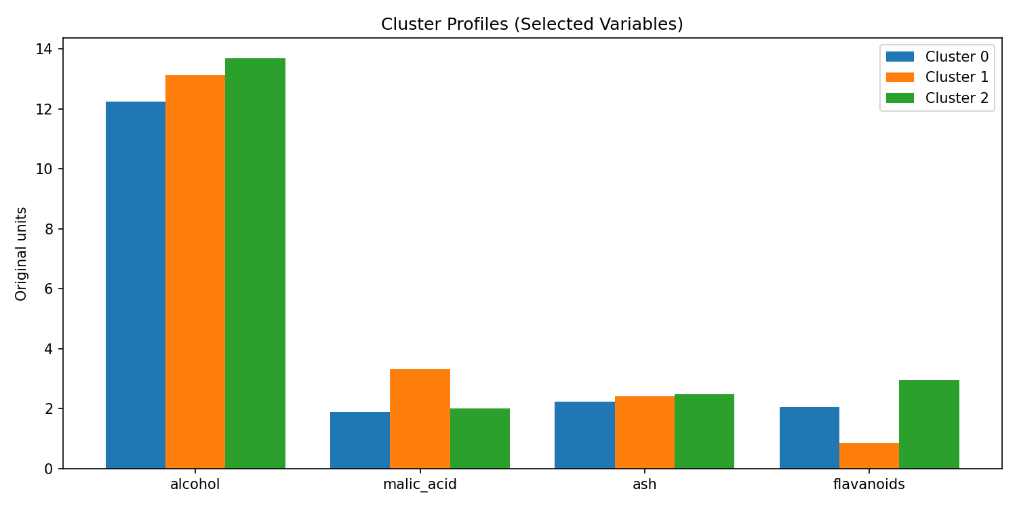
Part E: Cluster Profiles & Statistical Tests
Centroids (original units) show distinct profiles across alcohol/malic_acid/ash/flavanoids.
ANOVA & Kruskal–Wallis indicate significant differences (p<0.001).
import scipy.stats as stats km3 = KMeans(n_clusters=3, n_init=10, random_state=42).fit(X_pca) labs = km3.labels_ df = X_imp.copy(); df['cluster'] = labs groups = [g['alcohol'].values for _, g in df.groupby('cluster')] F,p = stats.f_oneway(*groups) H,pkw = stats.kruskal(*groups)

Slide 8
Summary & Reflection
Chosen model: K-Means (k=3) after PCA; Silhouette≈0.299, DB≈1.336, CH≈76.2.
PCA improved separation and stability; hierarchical results aligned but linkage-sensitive.
Next steps: GMM/DBSCAN, stability (bootstrap), per-sample silhouette.
# Final fit and quick 2D visualization from sklearn.decomposition import PCA p2 = PCA(n_components=2).fit_transform(X_scaled) lab = KMeans(n_clusters=3, n_init=10, random_state=42).fit_predict(X_pca) # plt.scatter(p2[:,0], p2[:,1], c=lab, s=25); plt.show()

